Slide 1
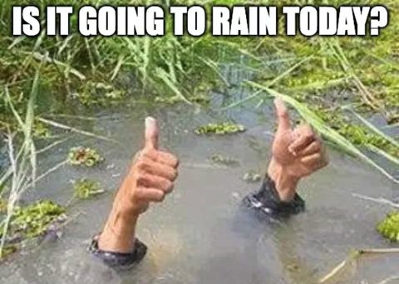
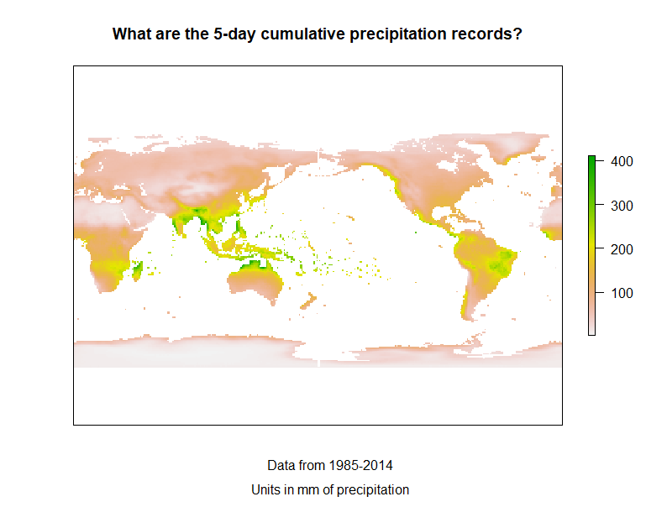
Rain, rain, go away, come again in >5 More days
An analysis of extreme rain events and their future likelihood
Joseph Silagi
Data Science and Policy

Slide 2

What are we analyzing?
Largest 5-day cumulative precipitation
Historical baseline
How much rain fell in the largest 5-day cumulative precipitation event?
Future simulations
How many times per year can we expect to break this historical baseline?
Change in Annual Exceedance Probability (AEP)
‘Baseline’ model = SSP2-4.5
SSP2: Middle of the Road (Medium challenges to mitigation and adaptation)
4.5: A target for radiative forcing by 2100 that is considered practical
Data from the Climate Change Knowledge Portal

Slide 3
Historical rainfall map

Slide 4
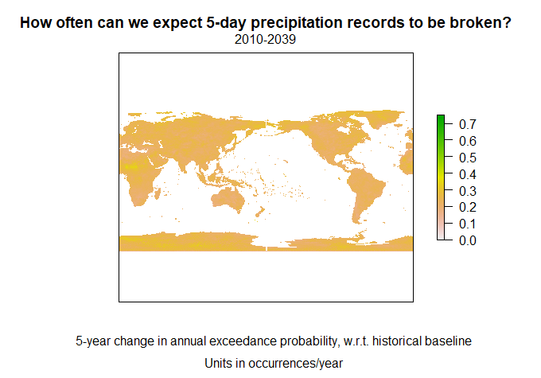
2010 – 2039 map

Slide 5

2035 – 2064 map

Slide 6

2060 – 2089 map

Slide 7
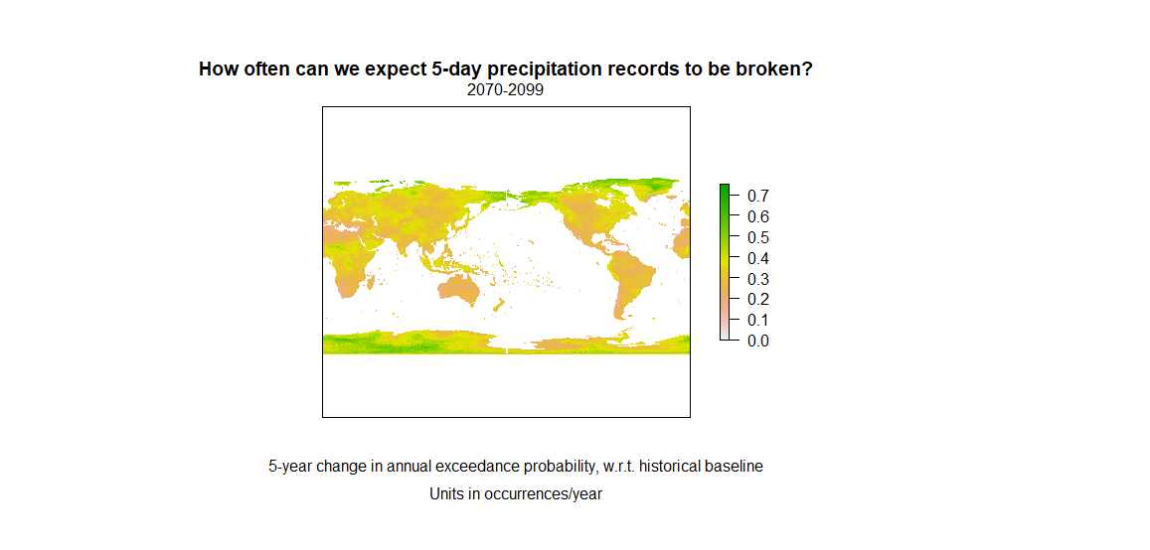
2070 – 2099 map

Slide 8
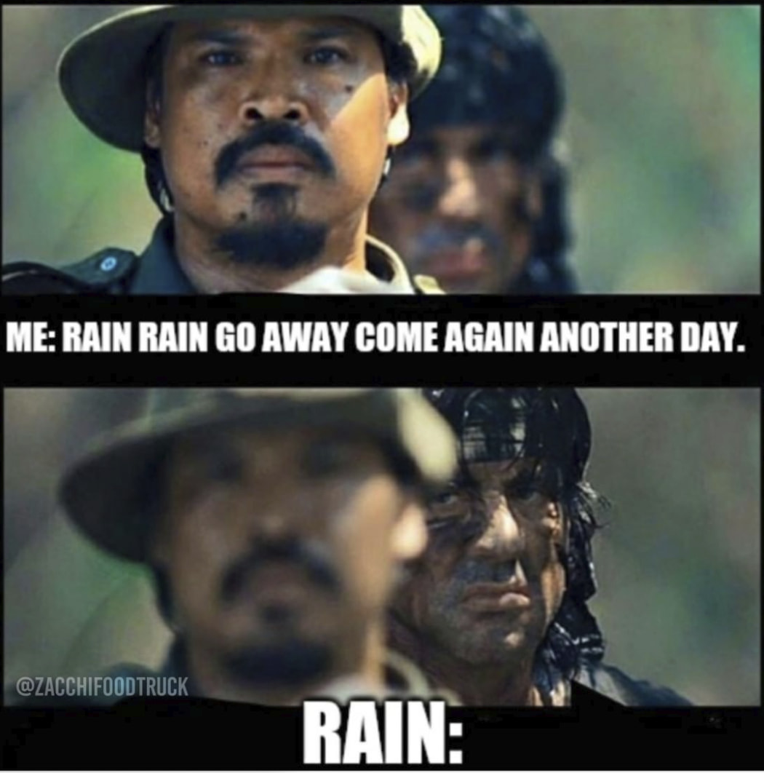
What can we modify?
Focus on specific regions
USA, Alaska, California, Delaware
Worldwide watershed basins
Change the scenario assumptions
SSP1-1.9
SSP1: Sustainability – Green Road (Low challenges to mitigation and adaptation)
1.9: Limits global warming to below the Paris Agreement
SSP5-8.5
SSP5: Fossil-fueled Development – The Highway (High challenges to mitigation, low challenges to adaptation)
8.5: Probable level of radiative forcing by 2100 if no significant actions are taken to mitigate CO2 emissions

Slide 9
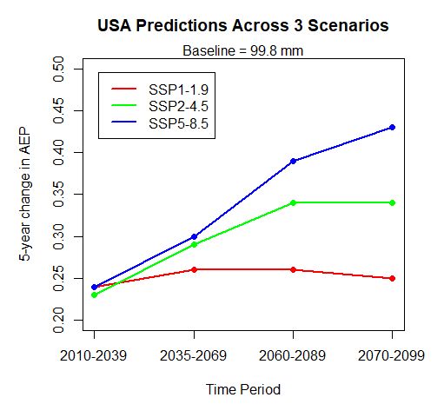
USA plot– comparing scenarios

Slide 10
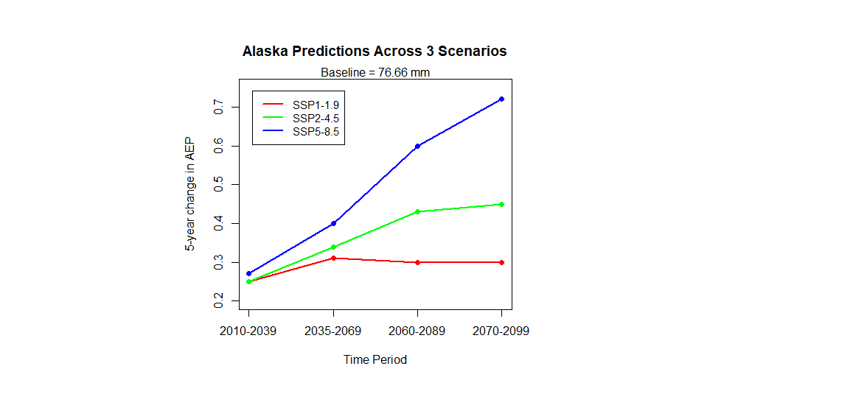
Alaska plot– comparing scenarios
High end of AEP

Slide 11
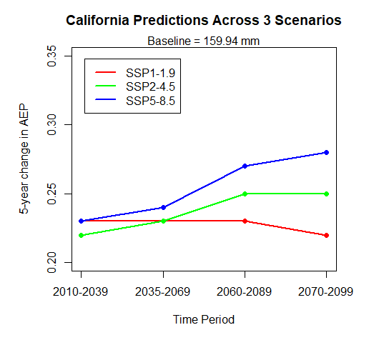
California plot– comparing scenarios
Low end of AEP

Slide 12
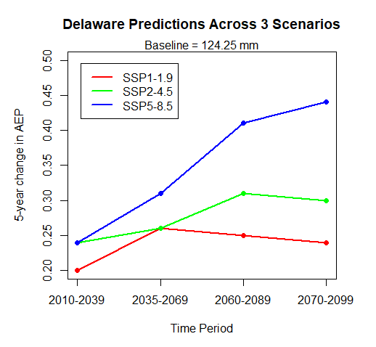
Delaware plot – comparing scenarios
Mid-range AEP

Slide 13
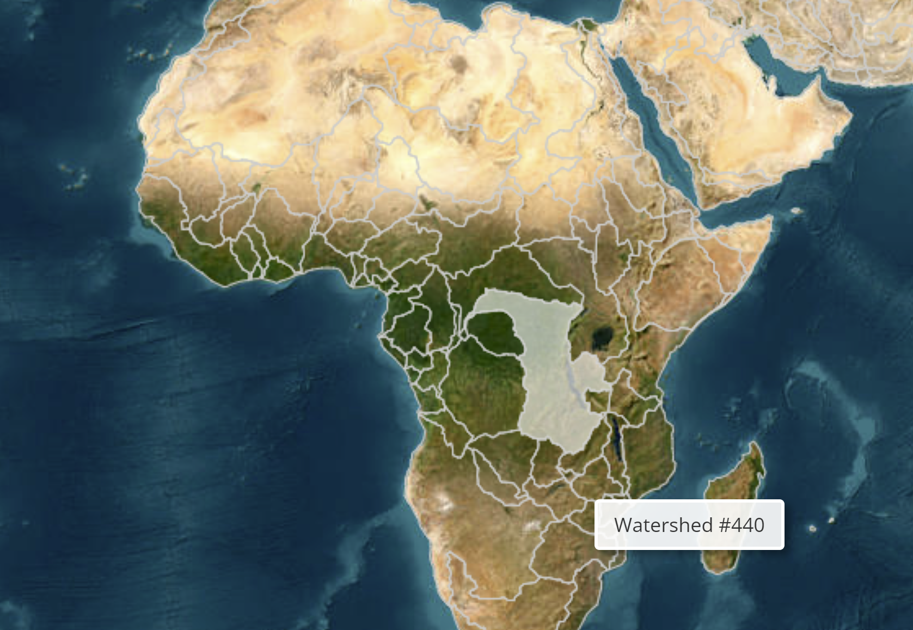
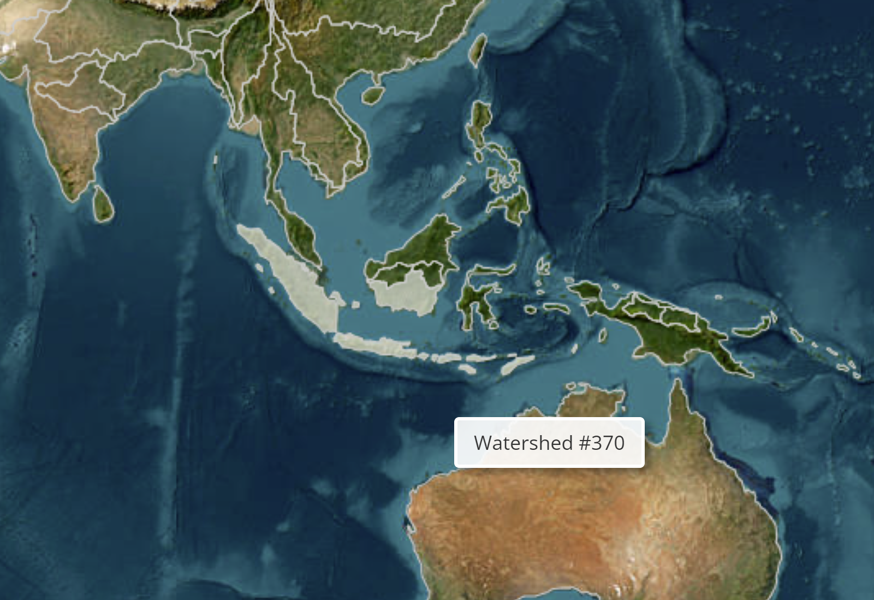
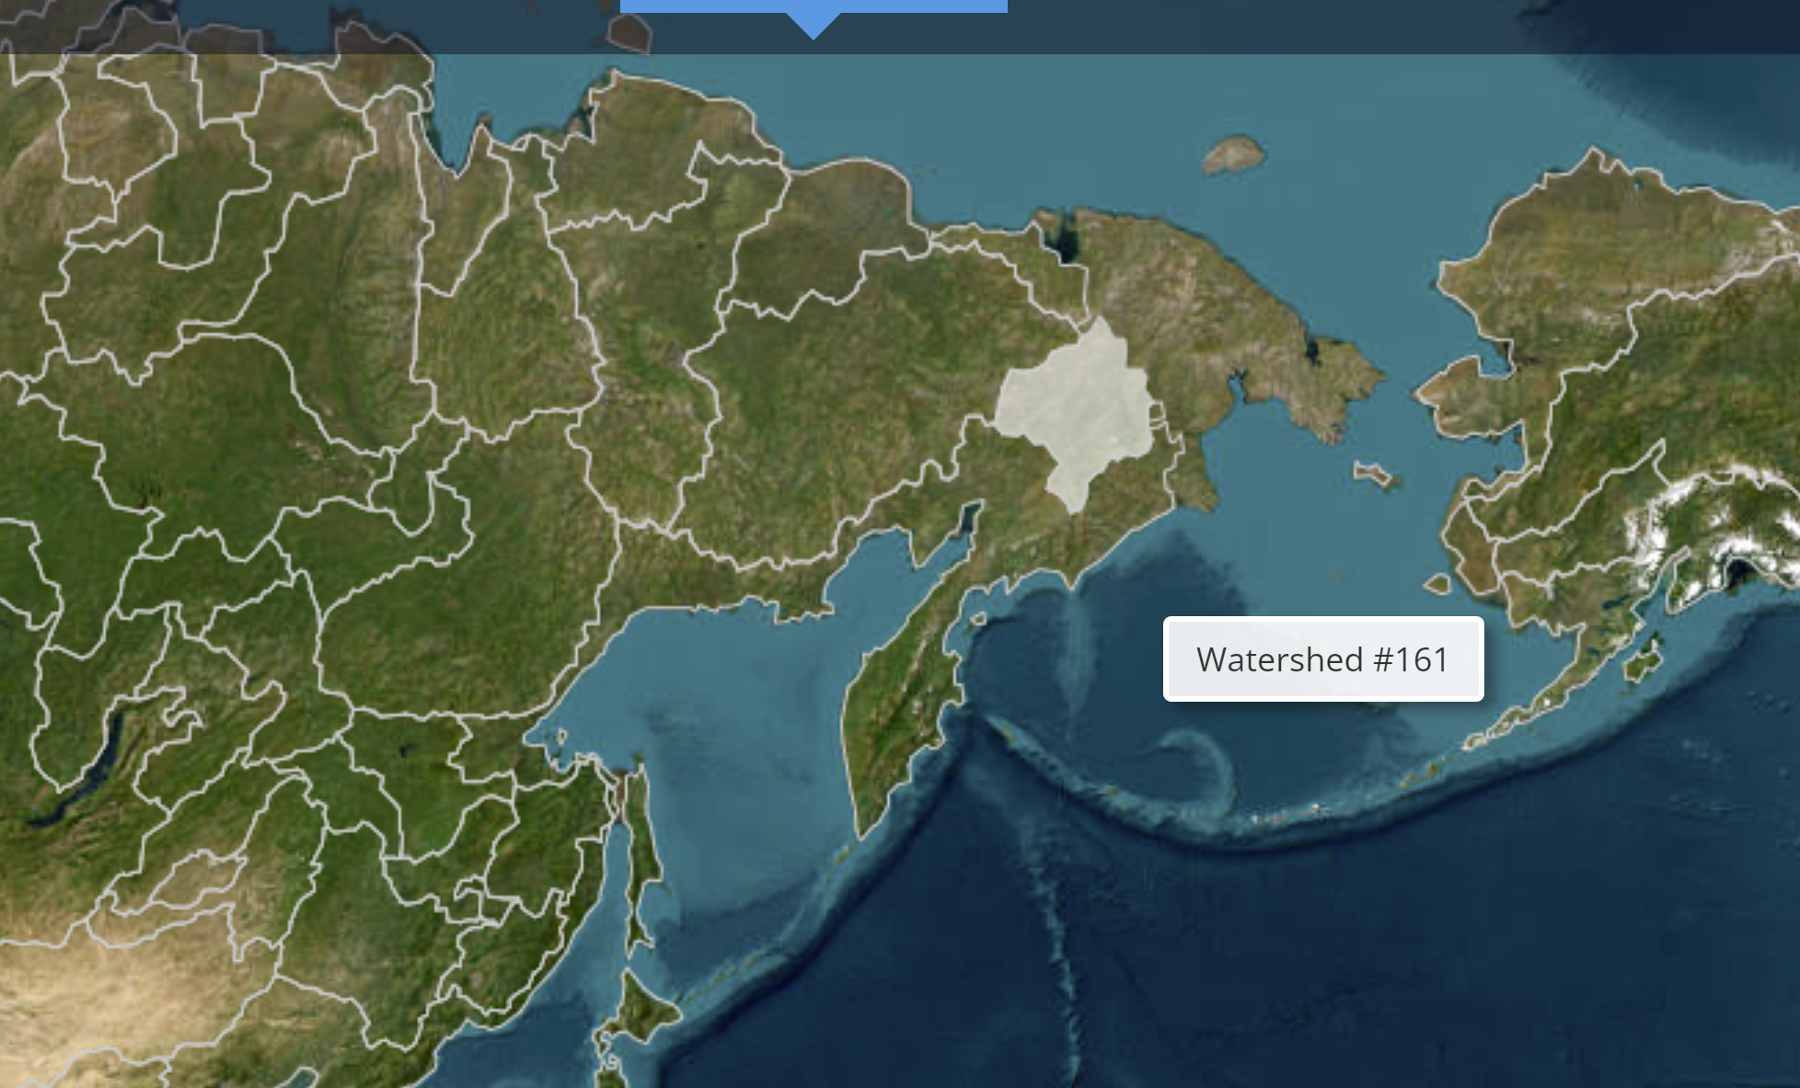
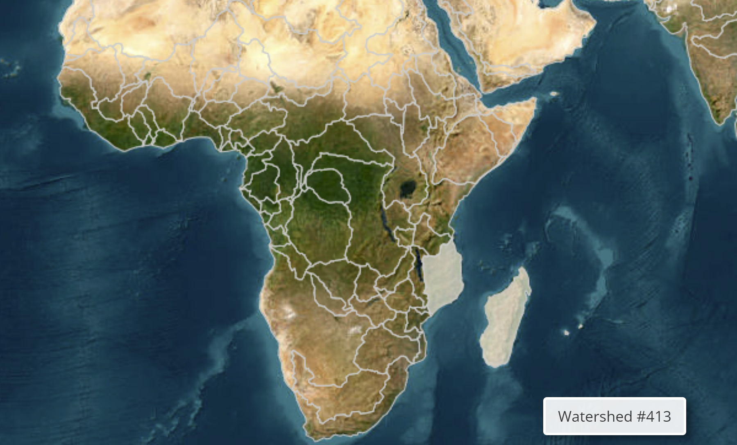
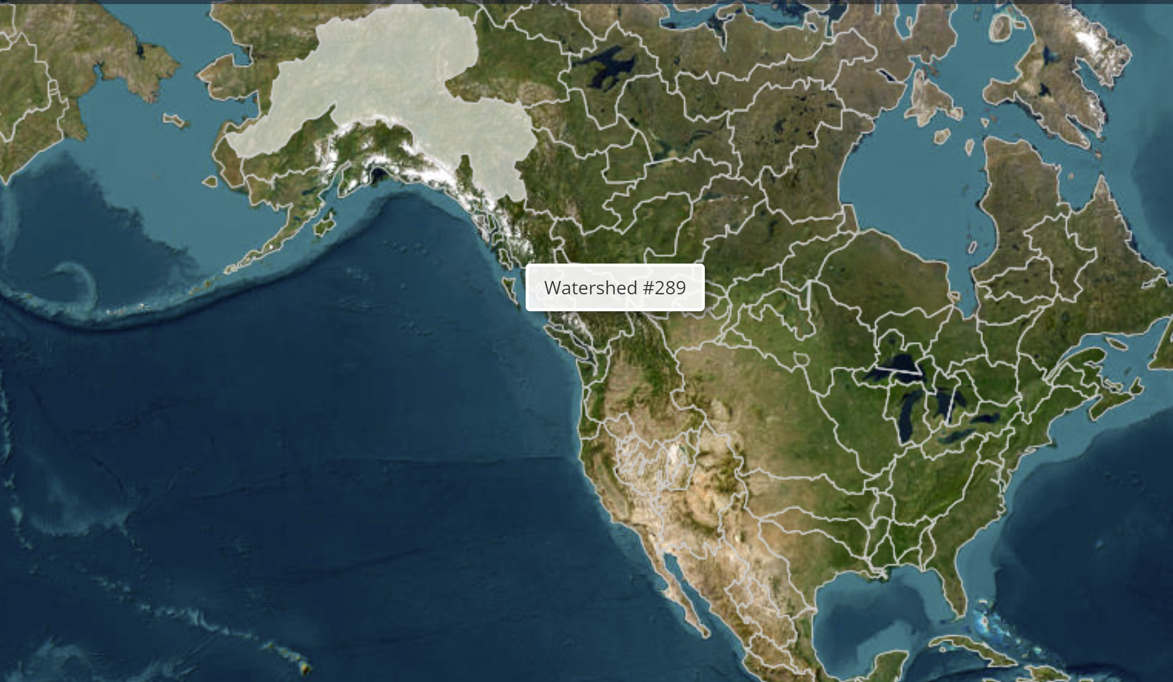
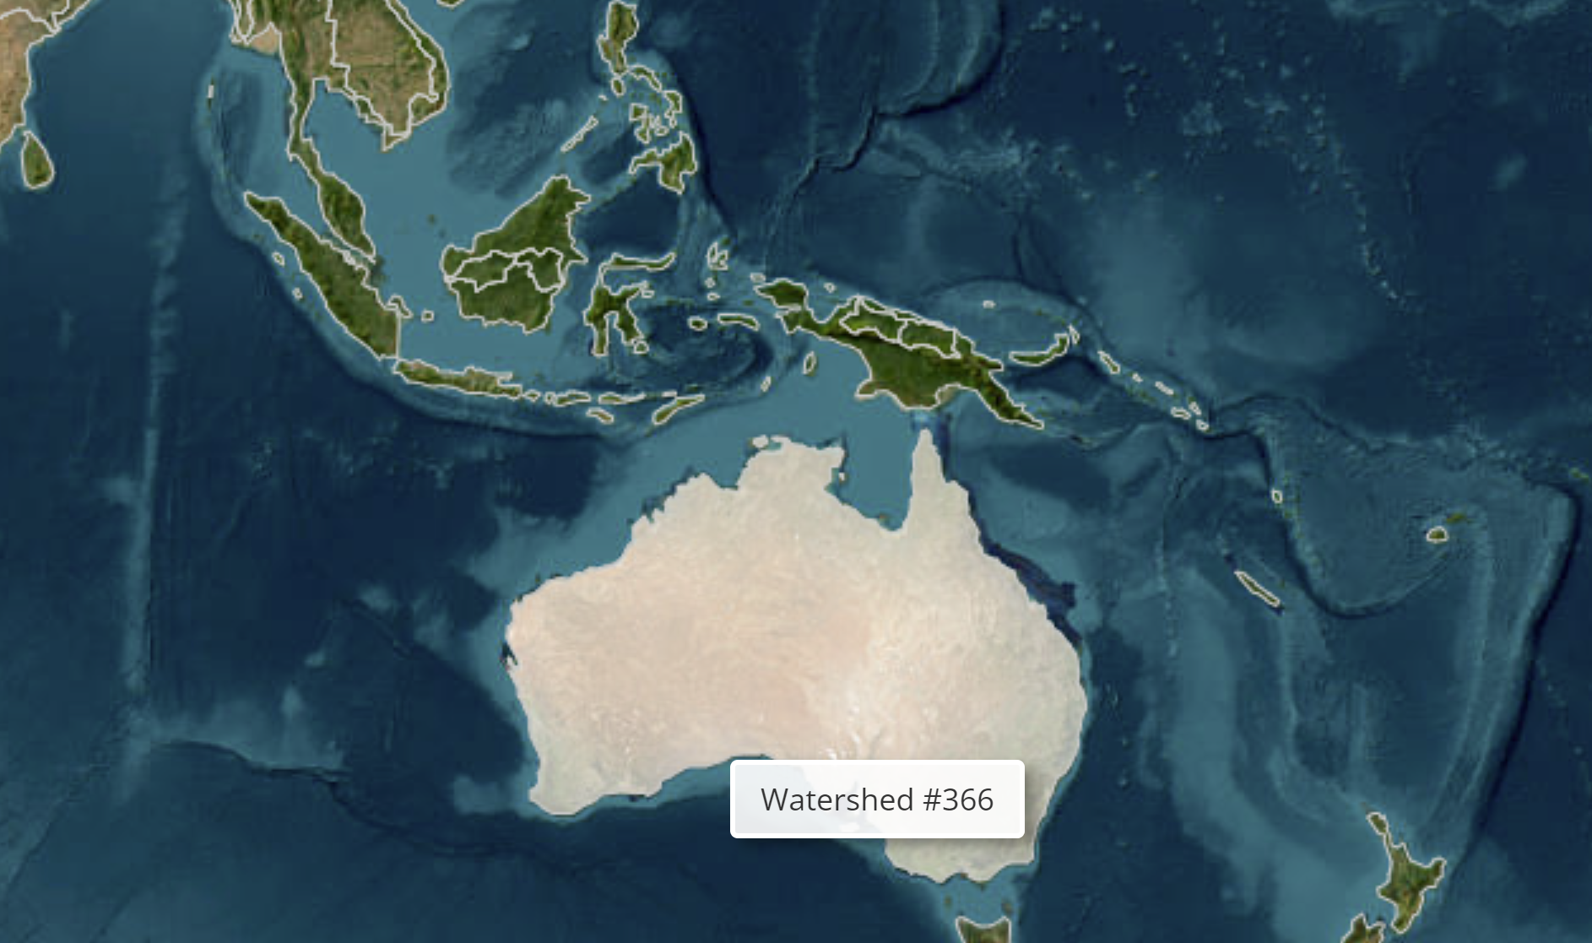
Worldwide – comparing watershed basins

Slide 14
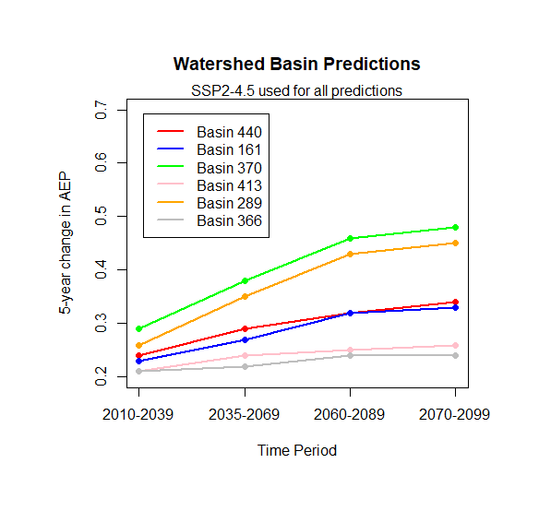
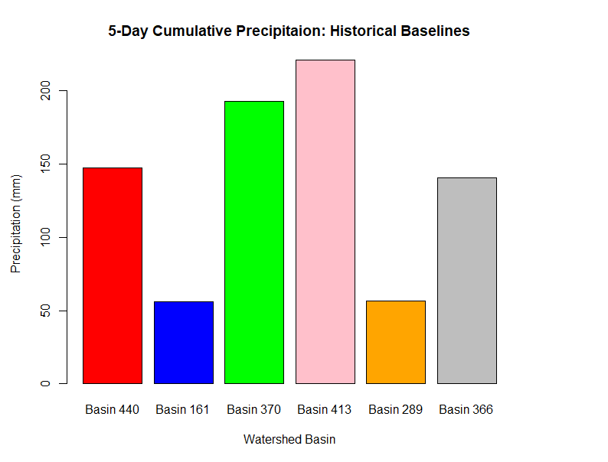
Worldwide – comparing watershed basins

Slide 15
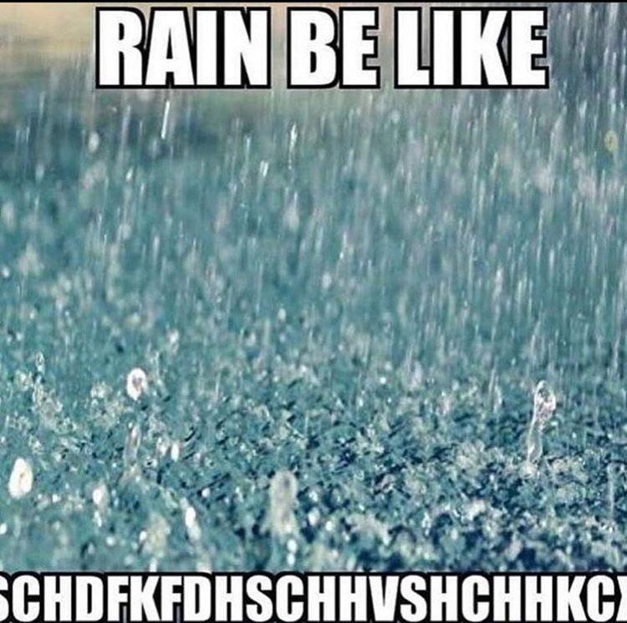
Conclusions
Variability in scenario assumptions
Variability in location
Extend analysis
Alter the variables
Largest 1-day precipitation
Largest cumulative monthly precipitation
Alter the percentile
Looked at Median (50th) for this analysis
Historic events will become commonplace

